Slide 2
Optimizing Power BI: Enhancing Performance Through Data Modeling

Slide 3


Peter van den Bos
Data Modeling & DAX Specialist Freelance Trainer & Speaker Founder @ DutchBiGeek
🌐 dutchbigeek.nl
🔗 linkedin.com/in/petervandenbos
🔗 github.com/PetervandenBos/
🗓️ sessionize.com/peter-van-den-bos
▶️ youtube.com/@DutchBIgeek
✉️ peter@dutchbigeek.nl
🧠 Geek by design ⚡ Because performance isn’t optional
Notes:
The first thing you should ask yourself is why the data model is important? → It’s the foundation of everything you do in Power BI.
Many customers ask me: → “My report is slow — can you fix it?” → In 80% of cases, the root cause is a poor data model.
A good data model reduces redundancy and improves performance.
I often see long and complex DAX queries. → Sometimes that’s necessary, but usually it means the model isn’t optimal. → The better your data model, the simpler your DAX becomes. → And simpler DAX = faster reports.
Power BI uses the VertiPaq engine. → It’s optimized for well-structured data models.
VertiPaq compresses data to improve memory efficiency. → Power BI is an in-memory tool. → RAM is expensive — so compression matters. → The more efficiently you compress, the more data you can store.

Slide 4
Why is the Data Model Important?
The data model is the foundation of Power BI.
A well-designed data model improves performance and speeds up queries.
80% of performance issues are related to the data model.
A better data model makes DAX queries easier and more efficient.
Reduces data redundancy and minimizes errors.
Notes:
The first thing you should ask yourself is why the data model is important? → It’s the foundation of everything you do in Power BI.
Many customers ask me: → “My report is slow — can you fix it?” → In 80% of cases, the root cause is a poor data model.
A good data model reduces redundancy and improves performance.
I often see long and complex DAX queries. → Sometimes that’s necessary, but usually it means the model isn’t optimal. → The better your data model, the simpler your DAX becomes. → And simpler DAX = faster reports.
Power BI uses the VertiPaq engine. → It’s optimized for well-structured data models.
VertiPaq compresses data to improve memory efficiency. → Power BI is an in-memory tool. → RAM is expensive — so compression matters. → The more efficiently you compress, the more data you can store.

Slide 5
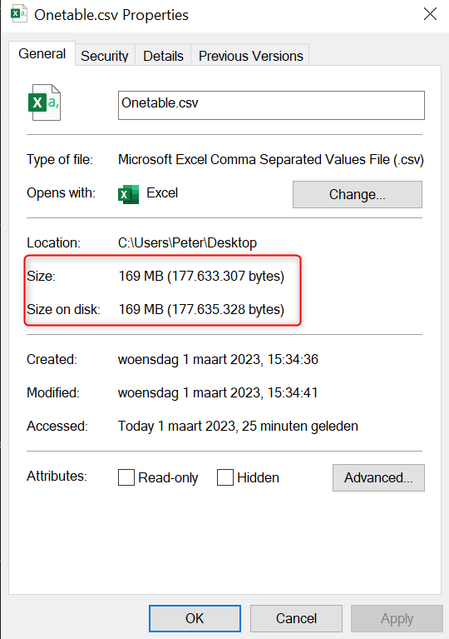
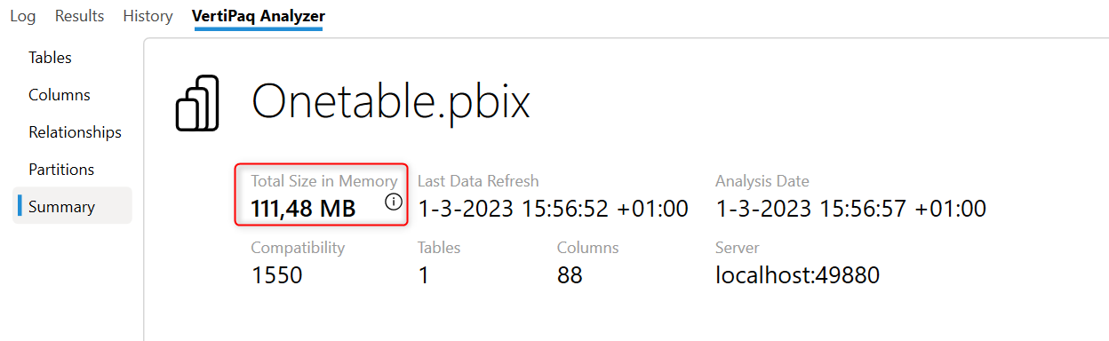
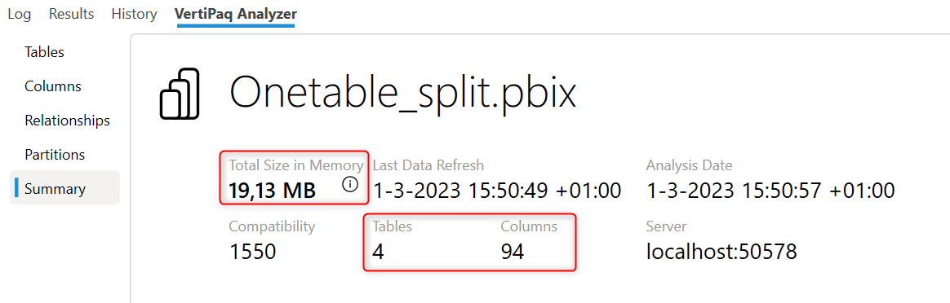
Example of Why the Data Model is Important.
Notes:
Compression is very important for performance in Power BI.
It’s essential to understand how data is loaded and what’s actually needed for the report.
Let’s look at how compression works when we don’t change anything yet:
One large Sales table = 169 MB (raw size).
After loading it into Power BI → 111 MB in memory.
So, VertiPaq already compresses it — much better than the source.
Now let’s optimize the model:
I redesign the data using fact and dimension tables.
Result: 4 tables, 49 columns — even more columns than before.
But now the total size in memory is just 19 MB.
Conclusion:
Relationships between tables help VertiPaq compress better.
A well-designed model = less memory, better performance.

Slide 6
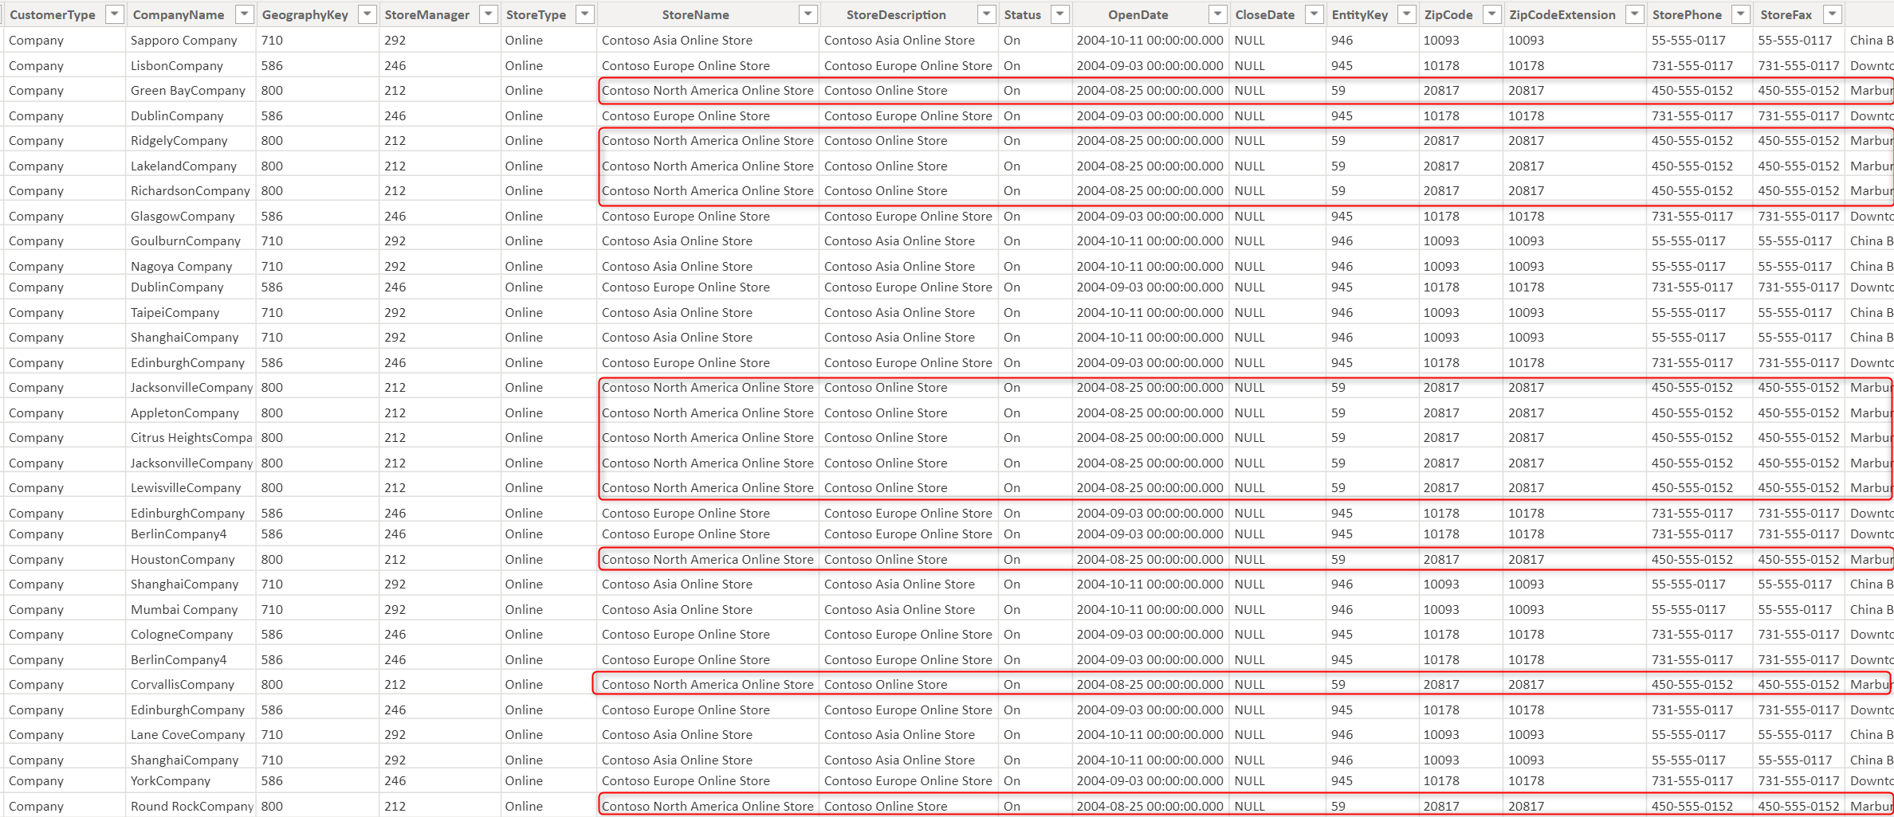
Example of Why the Data Model is Important.
Notes:
Let’s take a closer look at the big Sales table we loaded.
Each row contains full store information, such as:
Store description
Opening date
Address details
Example: Contoso North America Online Store is repeated on every row.
Ask the audience: → Is it helpful to repeat this store data on every row? → Answer: Not really — it’s inefficient and creates redundancy.
What did I do to fix this? → I moved all store information into a separate dimension table.
New structure:
A fact table with sales data
A dimension table with store data
Linked by a key column
Result: → A relationship between both tables → You can filter by store and see only the relevant sales → Without repeating store data on every row

Slide 7
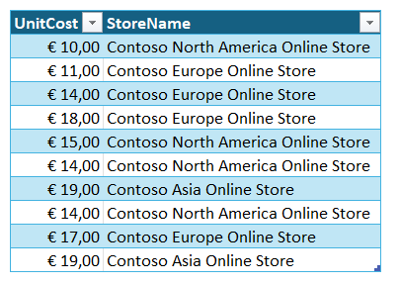
VertiPaq Compression
Notes:
So for example, I took two columns from. The one big table. So we can show how the Facebook compression is working on that. 2 columns. So we understand the compression technique. Found fresh bark a lot better.
Selected two columns from the large fact table as a focused example
Demonstrates how VertiPaq compression behaves on a limited dataset
Easier to observe encoding techniques like dictionary and run-length encoding
This simplified setup gives clearer insights into what’s happening under the hood

Slide 8
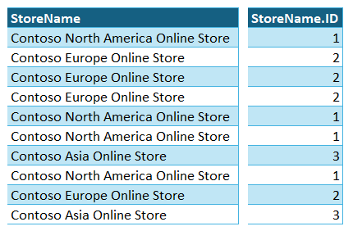
Dictionary Encoding
Replaces unique text values with numeric keys
Saves memory: text → integer
Values stored once in a dictionary, referenced via keys
Especially effective for low-cardinality columns
Notes:
The first thing VertiPaq does when compressing a column is apply dictionary encoding. But what does that mean exactly?
Let’s take a column with store names as an example. These values are often long text strings, like “Contoso North America Online Store.” Instead of storing that full name over and over again, VertiPaq replaces each unique text value with a numeric key.
So “Contoso North America Online Store” becomes key 1, “Contoso Europe Online Store” becomes key 2, and “Contoso Asia Online Store” becomes key 3.
This makes the column much smaller in memory, because numbers compress far better than long strings of text.
VertiPaq also creates a separate dictionary table behind the scenes. That table contains the mapping between the numeric keys and the original store names. So whenever the original name is needed—for example, in a visual—it can still be retrieved easily.
This technique works especially well when the column has low cardinality—meaning there are only a limited number of unique values. If the column has high cardinality, the dictionary becomes large, and the compression benefit is reduced.
The first compression technique VertiPaq applies is dictionary encoding.
Here's what happens:
Text values are replaced with numeric keys.
For example, "Contoso North America Online Store" becomes key 1.
"Contoso Europe Online Store" becomes key 2.
"Contoso Asia Online Store" becomes key 3.
This transformation reduces memory usage, since numbers compress much better than long text strings.
VertiPaq also creates a separate dictionary table that stores the mapping between the keys and the original text values.
This allows the engine to always look up the original names when needed (e.g., in visuals).
Dictionary encoding is very effective when a column has low cardinality (few unique values).
However, if a column has high cardinality (many unique values), the dictionary becomes large, and the compression is less efficient.

Slide 9
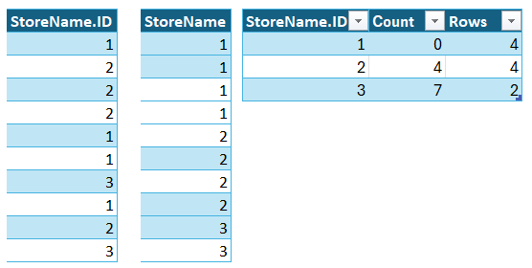
Run-Length Encoding (RLE)
Compresses consecutive repetitions of the same value
Stores as (value + count)
Only works well when the column is sorted
Applied only if it actually saves memory
Notes:
The next compression technique VertiPaq applies is run-length encoding.
Earlier, we saw that VertiPaq replaces long text values with numeric keys using dictionary encoding. Run-length encoding builds on that result.
Now that we have a column with numeric values—like store ID 1, 2, 3, etc.—VertiPaq looks at how often these values repeat in sequence. But for this to work effectively, the data needs to be sorted first. So the first thing VertiPaq does is sort the column by value, so that all identical values are grouped together.
Let’s say we now have a sorted column where the first four rows are all store ID 1, the next four rows are store ID 2, and the last four rows are store ID 3.
VertiPaq then builds a small internal table with three columns:
the value (e.g., store ID 1),
the starting row index (e.g., row 0),
and the number of consecutive rows with that value (e.g., 4 rows).
So instead of storing 12 individual values, VertiPaq now stores just three rows in this run-length encoded format.
Now imagine you have a column with one billion rows—but most values repeat in long sequences. With run-length encoding, VertiPaq could compress those billion rows into just a tiny table with a few thousand entries.
This leads to extremely efficient compression, especially when values repeat often and the data is properly sorted.

Slide 10
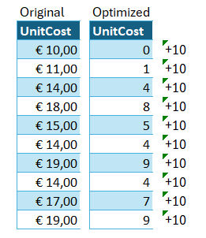
Value Encoding (Bit-Packing)
VertiPaq chooses the smallest number of bits per column
Smaller range of values = fewer bits needed
Works after dictionary encoding or on numeric columns
Notes:
The final compression technique VertiPaq uses is called value encoding, also known as base value encoding and bit-packing.
Let’s take a look at a numeric column, for example: [Unit Cost]. In this case, the values range from €10 to €19 — so only a small spread of values.
VertiPaq tries to optimize storage by asking: How few bits do I really need to store these values? The fewer bits needed, the better the compression.
Here’s what happens:
VertiPaq looks for the smallest value in the column — in this case, that’s €10.
It then subtracts this base value from every value in the column.
So €10 becomes 0, €11 becomes 1, and so on — until €19 becomes 9.
Now, instead of storing full decimal numbers like 10, 11, 12, VertiPaq just stores small integers starting from 0. That means fewer bits are required to represent each value.
For example:
To store numbers from 0 to 9, you only need 4 bits per value.
Compare that to storing larger numbers, which might require 8, 16, or even 32 bits.
And when VertiPaq needs to calculate or display the original value, it simply adds back the base value (in this case, €10).
So the more compact the values — the smaller the bit width — the less memory is used overall. This results in very efficient storage, especially for numeric columns with a narrow range of values.

Slide 11
Example of Why the Data Model is Important.
Notes:
Let’s take a closer look at the big Sales table we loaded.
Each row contains full store information, such as:
Store description
Opening date
Address details
Example: Contoso North America Online Store is repeated on every row.
Ask the audience: → Is it helpful to repeat this store data on every row? → Answer: Not really — it’s inefficient and creates redundancy.
What did I do to fix this? → I moved all store information into a separate dimension table.
New structure:
A fact table with sales data
A dimension table with store data
Linked by a key column
Result: → A relationship between both tables → You can filter by store and see only the relevant sales → Without repeating store data on every row

Slide 12
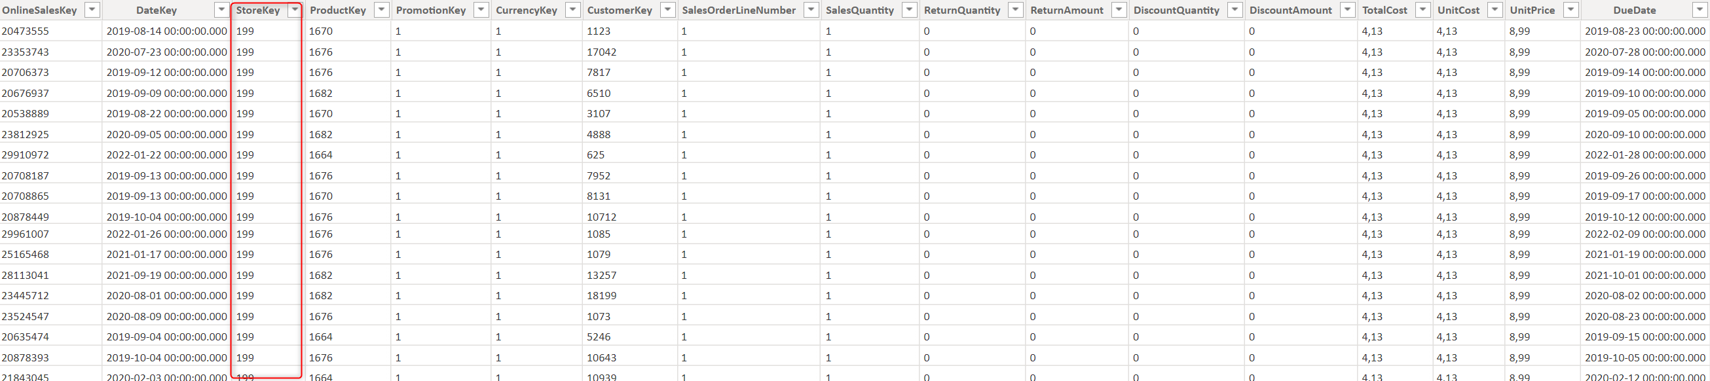
Example of Why the Data Model is Important.
Notes:
This sheet shows how we’ve split the store data from the fact table.
The store information is now in a separate dimension table.
As a result, we’ve removed redundancy — → Each store is only stored once.
This reduces the memory footprint, → It's more efficient than repeating store data on every row.
Imagine a fact table with 1 million rows: → If every row contains full store details, that’s a waste of space.
That’s why it’s a good practice to split fact and dimension tables.
A fact table: → Long and narrow → Stores measurable values (e.g. sales, quantity)
A dimension table: → Wide and descriptive → Used for filtering, grouping, and context

Slide 13
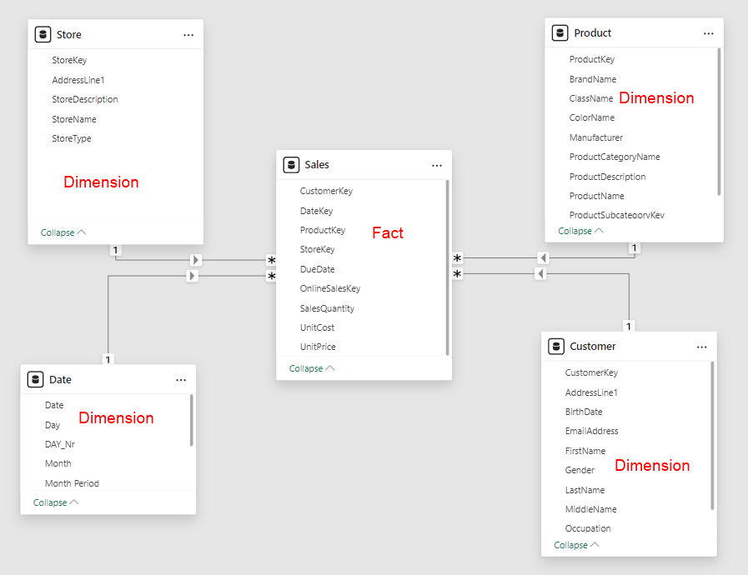
Star Schema
Fact Tables:
Contain facts, representing an event with dimensions.
A sale includes a product, a customer, and a date.
Metrics that can be aggregated to gain insights.
Dimension Tables:
Descriptive attributes of entities such as a product, customer, employee, or patient.
Dimensions have attributes like color, category, manufacturer, or price.
Notes:
VertiPaq compression improves when using fact and dimension tables
Best practice: build a star schema
A star schema has:
One fact table (e.g. Sales)
Multiple dimension tables (e.g. Product, Customer, Date)
Fact table contains:
Numeric values for aggregation (e.g. Sales Amount, Quantity)
Foreign keys to dimensions
Dimension tables contain:
Descriptive attributes
Used for filtering, grouping, slicing
Rule of thumb:
Chart axis = dimension
Chart bars = fact values
Only the key column appears in both tables (to define relationships)

Slide 14
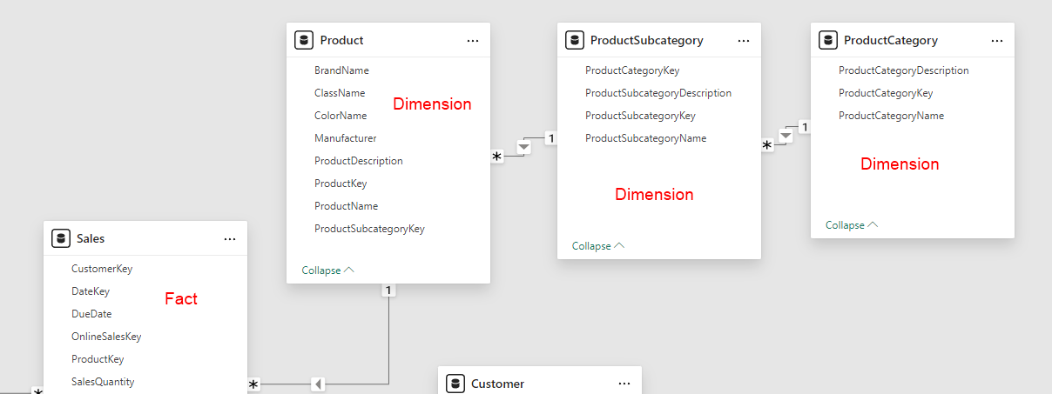
Snowflake-model
The Snowflake Schema is a Variant of the Star Schema
The difference is that dimension tables that are related to each other are connected.
For example:
Product
Product Subcategory
Product Category
Notes:
A snowflake schema is a variation of the star schema
In snowflake models, dimension tables link to other dimension tables
Example:
Product → Product Subcategory → Product Category
Only Product connects directly to the fact table
Still supports filtering across levels (via relationships)
Sometimes useful when a dimension table is too wide (too many columns)
Not ideal for performance — more joins needed
Snowflake is not wrong, but star schema is preferred for a well-designed data model

Slide 15
What Does an Optimized Data Model Consist Of?
The model consists of facts and dimensions.
A fact table contains values that you can calculate, such as:
Revenue, purchase date, sold products, etc.
A dimension table contains values you want to filter by, such as:
Year, month, manufacturer, customer, etc.
Notes:
Optimized model = facts + dimensions
Fact table → values you calculate
Examples: sales, revenue, purchase date
Dimension table → values you filter/group by
Examples: product, customer, year, month, region

Slide 16
Relationships and Keys
To create relationships between tables, keys are used.
Primary Key:
A unique value that appears only once in a dimension table.
Foreign Key:
Used in a fact table to indicate how often, for example, a product has been sold.
The foreign key can appear multiple times in a fact table, as a product is typically sold more than once.
Notes:
Two table types: fact and dimension
To connect them, we need a relationship
Based on a key column
In the dimension table:
Primary key (unique values)
Example: StoreKey, one per store
In the fact table:
Foreign key (repeated values)
Example: many sales for the same store = same StoreKey
Without a relationship, we can’t filter facts using dimension fields
Rule: primary key = one value per row, no duplicates

Slide 17
Relationships and Filtering
A relationship must be created between facts and dimensions. Possible relationships include:
One-to-many
One-to-one
Many-to-many
You can also choose the filter direction:
Single
Both
Notes:
Use a key column to create relationships (primary key in the dimension, foreign key in the fact table)
One-to-many is the most stable and recommended relationship
One-to-one is rare and can break if duplicates appear
Many-to-many is weak and often leads to unpredictable results → better to use a bridge table instead
Filter direction is typically single (from dimension to fact) → safest and most reliable choice
Bidirectional filtering can create an ambiguous model → increases the risk of incorrect or unclear results

Slide 18
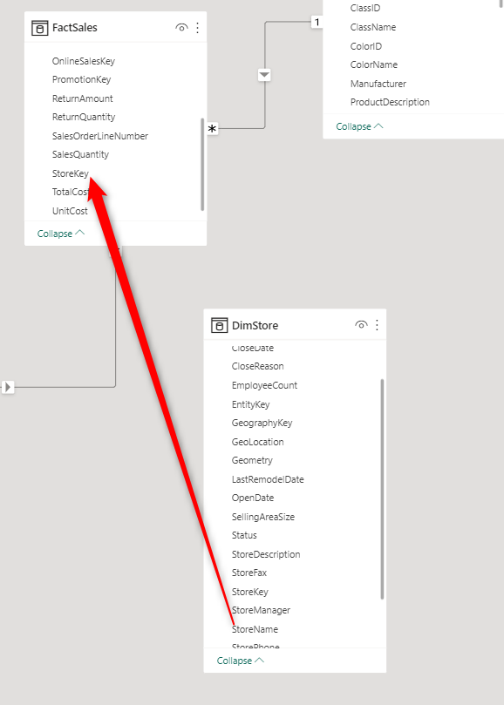
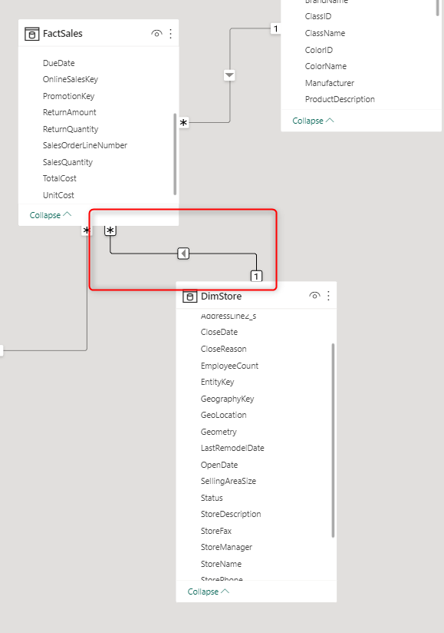
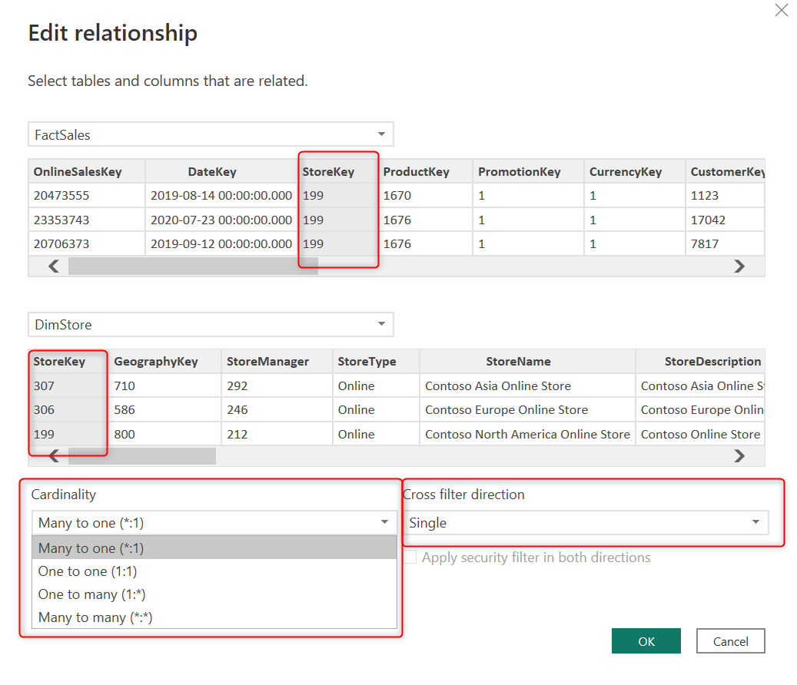
Example: Relationships and Filtering
Notes:
When you click Close & Apply in Power Query, Power BI attempts to auto-detect relationships
Often this works well, but sometimes Power BI doesn’t create a relationship, especially when:
Column names differ
There’s missing metadata
The join logic isn’t obvious
In these cases, you must create the relationship manually
How to create a relationship manually:
Open the Model view in Power BI
Click and drag the key column from one table to the matching key in another
Power BI detects cardinality and direction (e.g. one-to-many)
Tips:
If you drop the line on the wrong column, double-click the relationship line to edit it
In the edit dialog, you can:
Change the related columns
Set the cardinality (e.g. one-to-many)
Choose the filter direction (use Single, not Both)

Slide 19
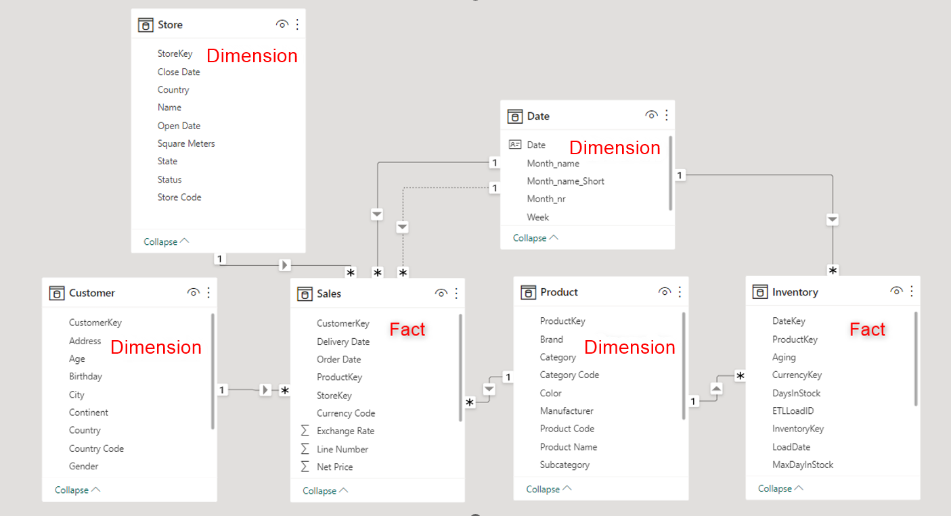
Multiple Fact Tables
It is possible to use multiple fact tables in your model.
These fact tables may not have much in common with each other
Inventory and sales.
However, it is necessary to have some dimension tables that are connected to the fact tables
date and product.
Notes:
A star schema typically has one fact table at the center
It's perfectly fine to have multiple fact tables in your data model
Example: a model with two fact tables: Sales and Inventory
Shared dimensions (e.g. Date, Product) can filter both fact tables
Some dimensions (e.g. Customer, Store) may only relate to one fact table
Filters on those dimensions won’t affect the other fact table
This is fine as long as you're aware of the relationships
You can also build a galaxy schema: multiple fact tables + shared dimensions
Use a galaxy schema for multiple business processes (Sales, Finance, Production...)
Important: each fact table should represent a separate, clear topic
Avoid overlapping facts across tables unless there's a strong reason
Design should reflect business logic and improve performance

Slide 20
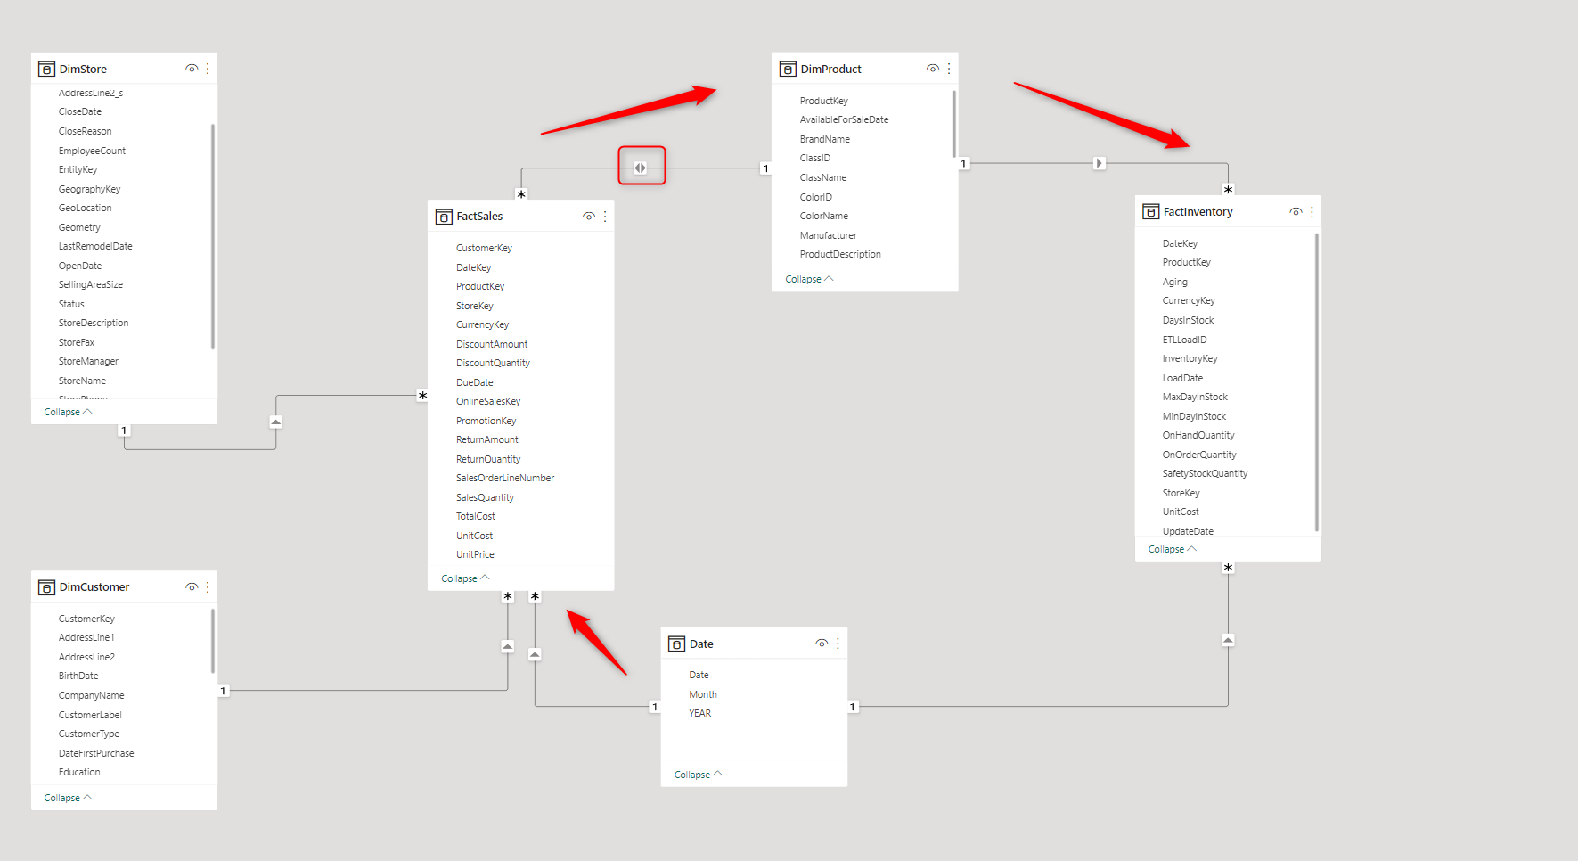
Ambiguity
When a model includes multiple fact tables and uses bidirectional relationships, there is a risk of ambiguity.
This means the model may not know which path to follow when filtering.
If it can filter through multiple tables, it may display incorrect values.
Notes:
Avoid using bidirectional relationships unless absolutely necessary
They increase the risk of an ambiguous data model
Ambiguity occurs when there are multiple filter paths between tables
This can lead to incorrect or unexpected results in your visuals
Example: a model where filters can reach the Sales table through different routes
Power BI may not know which path to use, causing confusion in your results
Best practice: use single direction filtering from dimension to fact
If you really need multiple filter paths, consider using DAX functions like TREATAS or CROSSFILTER explicitly
Always validate your data when using complex filter relationships

Slide 21
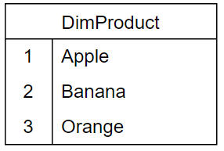
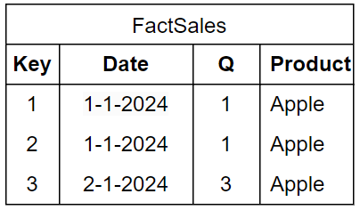
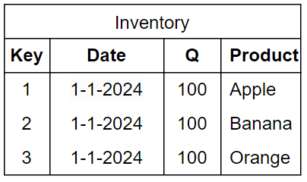
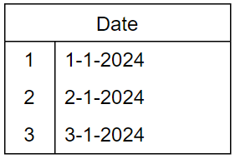
Example ambiguity
Notes:
In this example, we have a bidirectional relationship between Fact Sales and Dim Product.
The Inventory table shows 100 units for each product on January 1st.
Normally, Power BI filters directly from Date → Inventory, which shows correct results.
But with bidirectional filtering, Power BI can take an indirect path:
Date filter goes to Fact Sales (shows 2 Apples sold).
That filters Dim Product (only Apples remain).
Then filters Inventory → only Apples are shown.
The result: Bananas and Oranges are missing from the report.
This leads to incomplete and incorrect results.
In large models with many fact and dimension tables, this problem becomes harder to detect.
You lose control over the filter paths in your model.
Avoid bidirectional relationships to prevent ambiguous results and data errors.

Slide 22
Multiple date tables
When comparisons need to be made between dates, multiple date tables are sometimes used.
The reason for this is that you can only have one active relationship between tables.
This adds extra data to your model, which can be inefficient.
It is better to use the USERELATIONSHIP function in DAX.
This allows for easier comparisons, and the relationship only becomes active when the measure is used.
Notes:
Multiple date tables: Sometimes used when a fact table has several date columns, each connected to a separate 'Date' table.
Inactive relationships: Only one active relationship can exist between a dimension and fact table at a time. Additional relationships appear as dotted lines (inactive).
Inefficient solution: Creating multiple 'Date' tables duplicates data unnecessarily.
Better approach: Use inactive relationships with DAX queries to activate them when needed, avoiding data duplication.
Example: A demonstration of how to activate inactive relationships with DAX will follow.

Slide 23
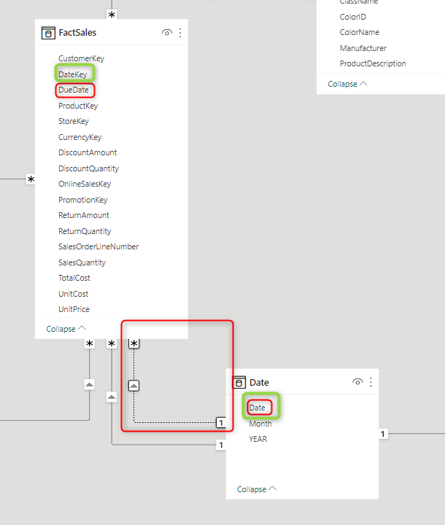
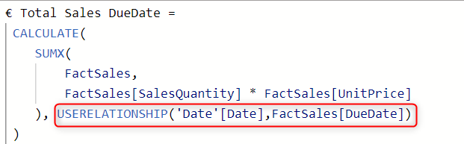
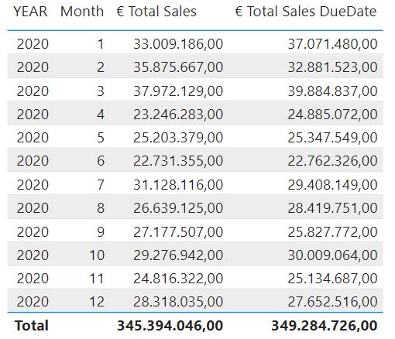
Example of multiple date tables
Notes:
Avoid using multiple Date tables to compare dates — it’s not necessary
Use one central Date table for all your date relationships
You can create multiple relationships between the Date table and your Fact table
Only one relationship can be active at a time
Others remain inactive (shown as dotted lines in the model)
Use USERELATIONSHIP() in DAX to activate an inactive relationship temporarily
Example: Compare Order Date (active) vs Due Date (inactive)
Wrap your measure in CALCULATE() and use USERELATIONSHIP() for the second date
Keeps your model clean, simple, and optimized
Recommended pattern: Single Date table + multiple relationships, not multiple Date tables

Slide 24
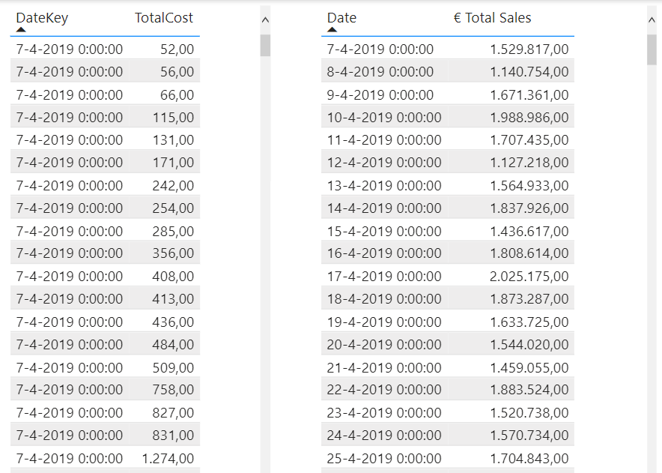
Level of detail in the tables
The level of detail at the lowest level in your table.
Consider what is needed at the lowest level of the table, for example:
What is the lowest level of each individual purchase?
Is it sufficient to store the revenue per day?
Notes:
A well-designed data model starts with understanding report requirements
Determine the necessary level of detail (e.g. daily totals vs. individual transactions)
More rows in your fact table = higher memory usage and slower performance
Only include detailed data if it’s essential for the report
Aggregating data before loading it into Power BI reduces memory usage
Example: daily sales totals require fewer rows than full transaction data
Always ask: What is the lowest detail level we need?
This decision significantly impacts model performance and clarity

Slide 25
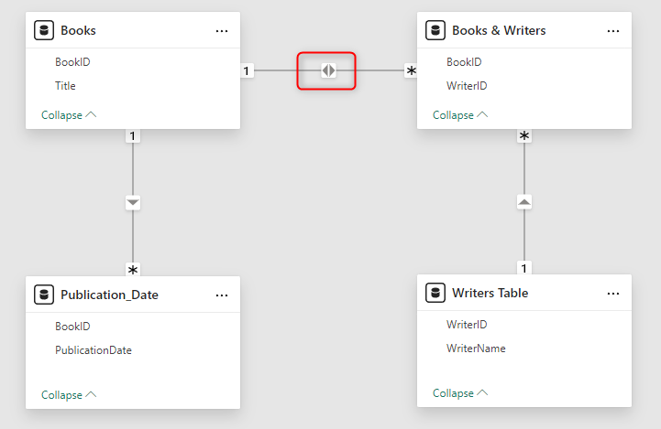
Many-to-many relationships
Many-to-many (M:N) relationships
Example: Accounts and Customers (CRM vs. ERP)
How to solve this?
Create a bridge table:
Make a table containing all keys.
Pay attention to the direction of the cross-filter:
Filtering only works from the 1 to * side.
Notes:
Many-to-many relationships are weak and should generally be avoided in Power BI.
A classic example: one writer can write many books, and one book can have multiple writers.
Direct relationships between Books and Writers tables lead to ambiguity and unreliable results.
Use a bridge table (e.g. BookWriters) to store combinations of BookID and WriterID.
Create two one-to-many relationships:
Writers → BookWriters
Books → BookWriters
This replaces the many-to-many setup with two strong one-to-many relationships.
To filter from Writers to Books, enable bidirectional filtering only in this specific case.
This ensures the filter can flow from writer → bridge table → books.
Only use bidirectional filtering when necessary and controlled — this is a valid exception.
Result: a clean, performant, and reliable model with accurate filtering behavior.

Slide 26
Importance of the Star Schema for VertiPaq
Star schema boosts performance:
Faster queries by separating dimensions and facts.
Simplifies data for efficient VertiPaq processing.
Proper data preparation is key:
Consistent data format ensures better compression and lower RAM usage.
Small tweaks, big gains:
Minor adjustments can greatly improve performance.
Next: Three key factors for optimizing compression.
Notes:
A star schema boosts performance by simplifying structure and enabling faster queries
Separating facts and dimensions improves processing and reduces model complexity
Consistent data formatting helps with better compression and lowers RAM usage
Small changes can lead to significant performance improvements
Next: 3 key factors for optimizing compression in your data model

Slide 27
Importance of Choosing the Right Data Types
Select the correct data types to optimize model performance
Understand data requirements and report needs
Power Query defaults to "Decimal" for numeric columns:
May lead to unnecessary digits after the decimal point
Evaluate if fewer decimal places or whole numbers are sufficient
Correct data type choice is crucial for VertiPaq compression
Notes:
Choose the correct data types to improve compression
Avoid loading unnecessary decimal precision into your model
Too many digits = higher cardinality = less efficient compression
Reduce precision or convert to whole numbers where possible
Power Query may need manual adjustments to optimize data types

Slide 28
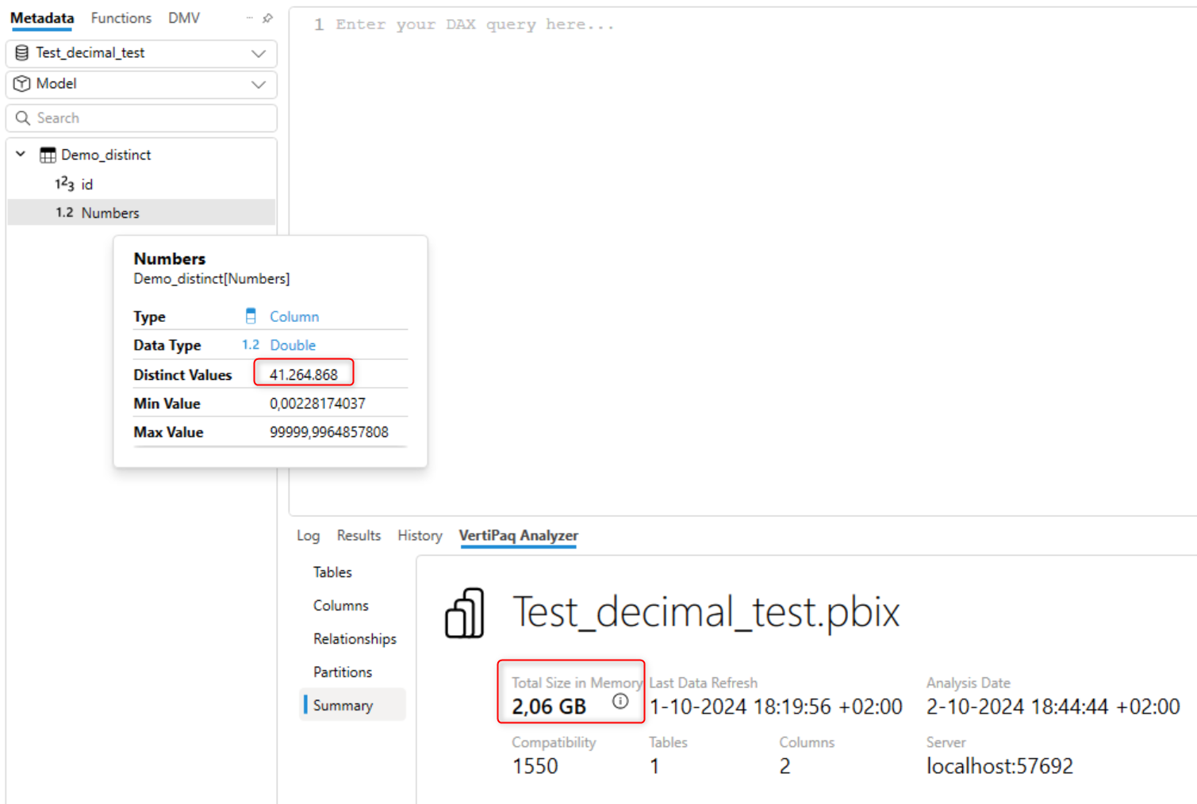
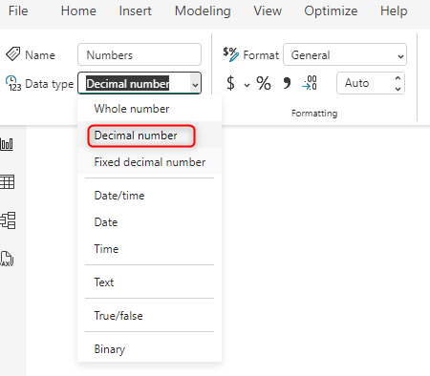
Example Decimal number
Notes:
Original dataset: 41 million rows with 11-digit decimal values
Model size: 2 GB using default Decimal Number type
Report only needs 4 decimals → higher precision is unnecessary
Solution: convert column to Fixed Decimal Number in Power Query
Fewer unique values → better compression → smaller model
Simple type change can significantly improve performance

Slide 29
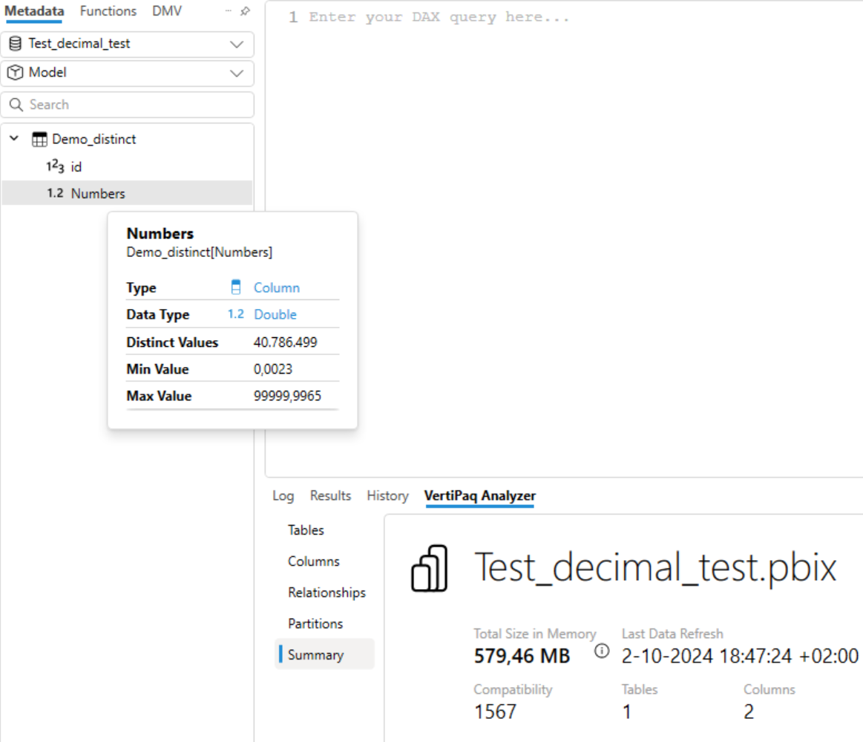
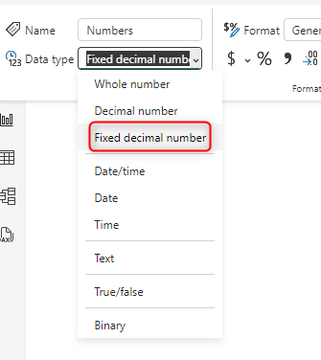
Example Fixed Decimal number
Notes:
Data type changed: Decimal Number → Fixed Decimal Number
Model size reduced from 2 GB → 580 MB (25%)
Fewer unique values = better compression by VertiPaq
Always ask: “Is this data type necessary for my report?”
Round or simplify when precision is not needed
Adjust data type in Power BI or at source for best results
Small changes = big performance gains

Slide 30
Optimizing Data Loading for Compression
Load only necessary data to achieve optimal compression
Reduce the number of columns per table:
Fewer columns lead to more effective compression
VertiPaq sort order technique: Stores columns with the lowest cardinality first for better compression
More columns, especially with higher cardinality, reduce compression efficiency
Limit to around 15 columns per table to maintain an efficient model
Notes:
Load only necessary columns into your data model
Fewer columns = better compression
VertiPaq relies on sort order for effective encoding
Too many columns make sorting inefficient
Aim for max ~15 columns per table (guideline, not a rule)
Always evaluate: Is this column needed in the model?

Slide 31
Calculated Columns: Pros and Cons
Calculated columns are useful during development:
Allow for quick testing and validation without modifying data sources
Provide flexibility and speed up development
Limitations of calculated columns in production:
Added after model compression, not compressed efficiently
Increase memory usage and reduce performance
Can undo optimization efforts by increasing model size
Notes:
Avoid using calculated columns in your data model
Use them only during development for testing logic
Calculated columns are not fully compressed
They are created after the data is loaded, during processing
Prefer creating columns in Power Query or the data warehouse
This ensures full compression and better performance

Slide 32
Best practices
Always use a star schema, or a snowflake schema if necessary.
A fact table contains values for calculations.
A dimension table contains values for filtering.
Avoid using bidirectional relationships.
Include only the data you actually use.
Determine the level of detail for your tables in advance.
Choose the right data type for each column
Notes:
Use a star schema (snowflake if needed)
Fact tables: store calculations and foreign keys
Dimension tables: used for filtering and grouping
Avoid bidirectional relationships
Load only the necessary data
Define the required granularity in advance
Choose the right data type for each column

Slide 33

If you have questions or insights, please contact me !
Notes:
Thanks for attending!
Use today’s tips in your daily work:
Compress data effectively
Build clean, high-performance models
I’ll be around all week at SQLBits — feel free to ask questions
My contact details are on the final slide
Reach out anytime — and enjoy SQLBits!

